Slide 1

Essential Techniques for Deep Learning to Avoid Overfitting
Harsh Kumar, Gojek
13th July 2024

Slide 2
Why is difficult to train neural networks
A Recipe for Training Neural Networks, Blog by Andrej Karpathy (link)
Neural net training is a leaky abstraction
Not plug-and-play like standard software APIs
Neural network training fails silently
Beyond syntactic errors, error surface is large
The Recipe
Understand Data
Get Dumb baseline
Overfit
Regularize
Tune
Squeeze out the juice

Slide 3
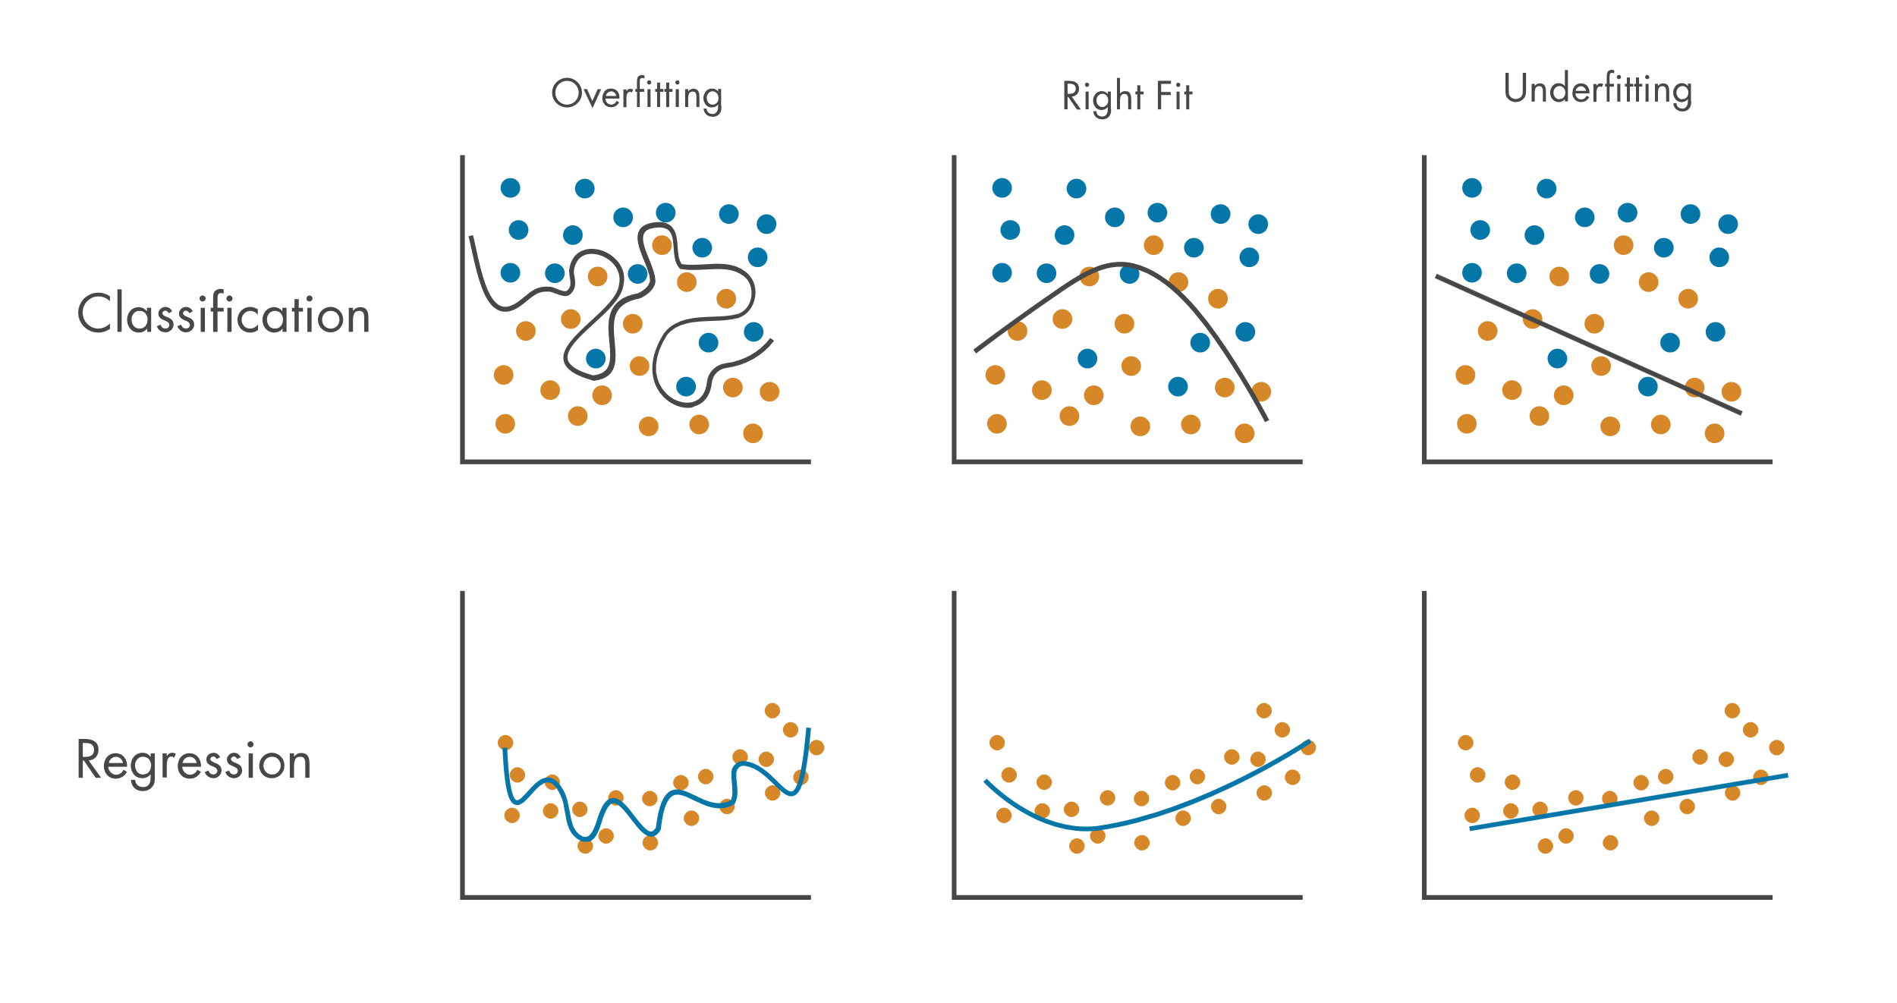
What is Overfitting?
When model learns the training data too well, including noise and outliers, resulting in poor performance on new, unseen data
The model captures details that are specific to the training data but does not generalize to the broader datasets
Image Source: https://www.mathworks.com/discovery/overfitting.html
We want good prediction accuracy not only on the training data, but also on unseen real-world data
Notes:
Poor generalization: The model fails to perform well on new, unseen data.
High variance: The model is sensitive to small fluctuations in the training data.

Slide 4
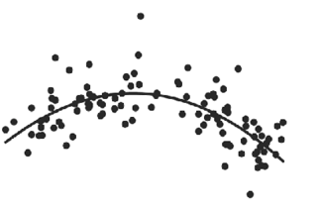
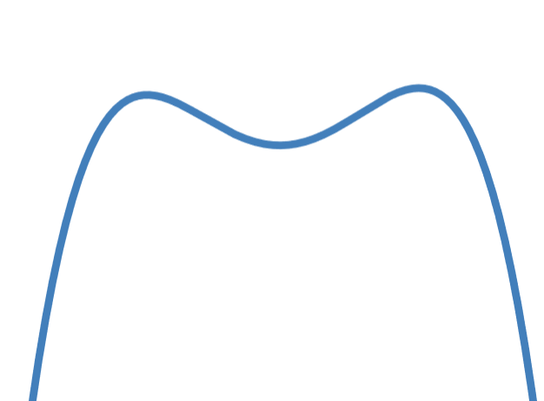
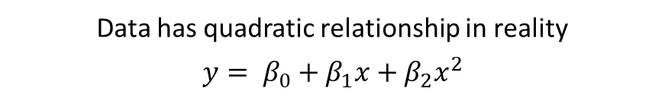

What causes overfitting?
More complex model than required
Insufficient training data
Too many irrelevant features
Using very complex model with low amount of training data
Data has quadratic relationship in reality
$$y= β_{0}+β_{1}x+β_{2}x^{2}$$
Model equation is complex
$y= β_{0}+β_{1}x+β_{2}x^{2}+β_{3}x^{3}$ $+β_{4}x^{4}$
Notes:
Reduce number of features
Decrease the coefficients of features

Slide 5
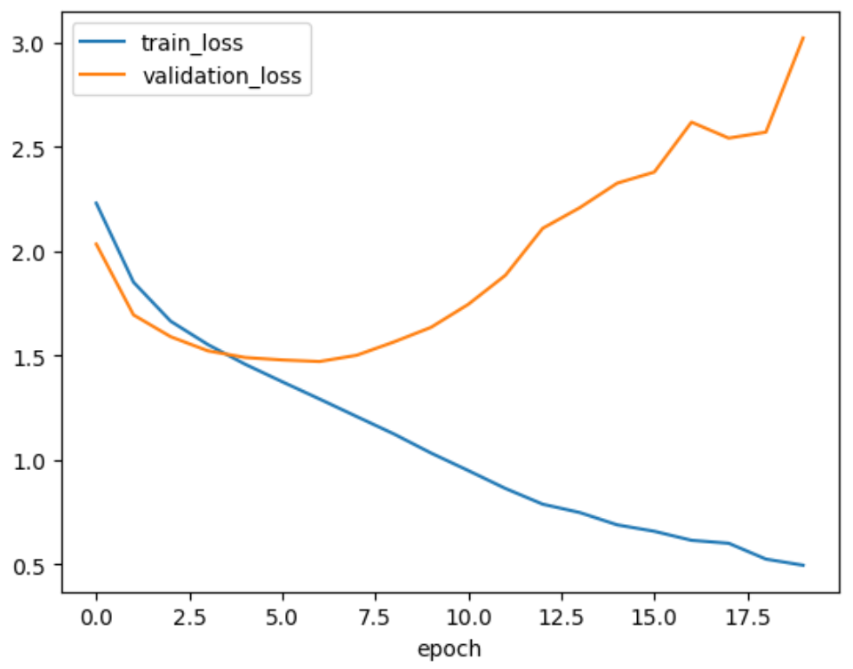

How to detect overfitting?
Training loss much lower compared to validation loss
Validation loss increases as number of epochs¹ increase
Always track model performance on properly constructed validation dataset
1. An epoch is when all the training data is used at once and is defined as the total number of iterations of all the training data in one cycle for training the machine learning model
Notes:
Including irrelevant features can lead to capturing noise rather than signal

Slide 6
Techniques to Avoid Overfitting

Slide 7
First things to check
Overfitting happens when the model is too complex compared to the patterns in the input data
Understand your data
Is the training and validation/test data coming from the same distribution?
Is the data clean enough? Check for outliers, missing values, duplicates, corrupted images or wrong labels
Are the features normalized? Is there a class imbalance?
Can we get more data – easily, quickly, cheaply?
Choose the right model
Reduce model parameters (# hidden layers, # neurons per layer)
Try simpler approaches like random forest, logistic regression, CART

Slide 8
Early Stopping
Stop training when validation loss stops reducing
Early stopping

Slide 9
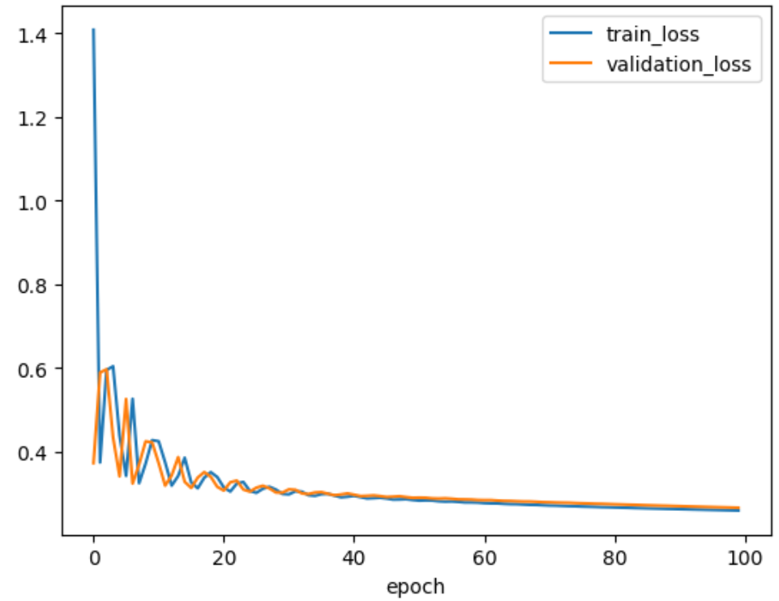
Early Stopping
Use early stopping even validation loss is not increasing
Early stopping
Why: Reduces chances of overfitting on unseen data + Saves compute and time
How: Stop training when validation loss doesn’t reduce by more than x%

Slide 10
Dropout
What: Dropout involves randomly ignoring a fraction of neurons during training
How:
Dropout probability determines the fraction of neurons ignored
Remaining neurons are scaled up (if dropout probability if 50%, then the output of remaining ones are multiplied by 2)
No dropout during inference time
Why:
Reduces co-adaptation of neurons
Acts as an ensemble of networks
Promotes redundant representations
Source: https://www.analyticsvidhya.com/blog/2022/08/dropout-regularization-in-deep-learning/
Dropout probability is typically 20% to 50%, but experiment for your use case
Notes:
Neurons can become co-adapted, meaning that certain neurons only function well in the presence of specific other neurons. This co-adaptation leads to overfitting because the network learns complex patterns that are specific to the training data but do not generalize to new data
Forces the network to spread the learned information across multiple neurons, promoting redundancy

Slide 11
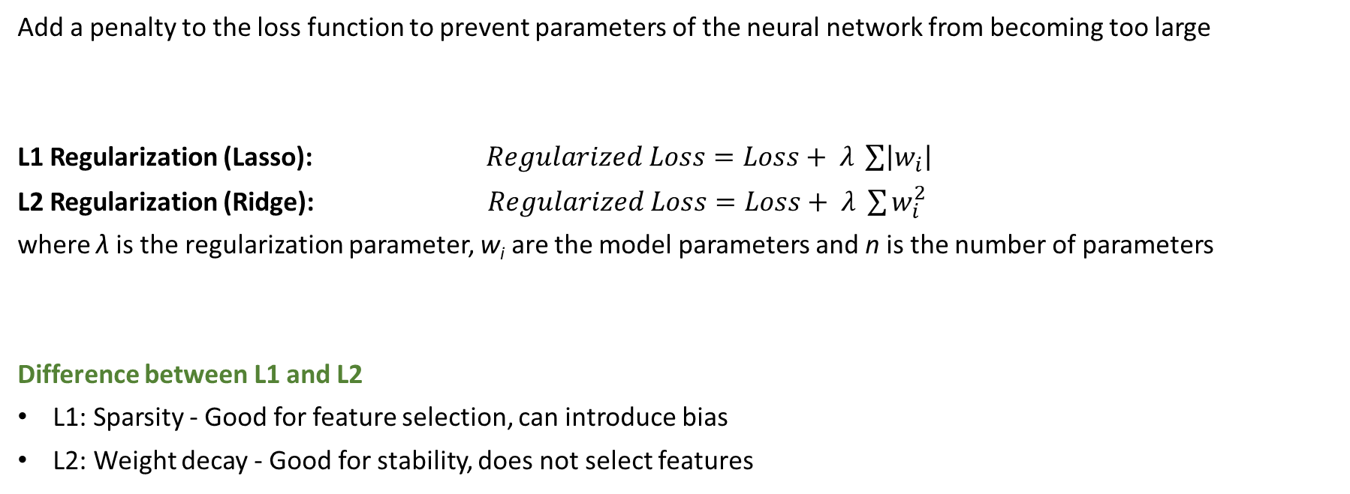
L1 and L2 Regularization
Add a penalty to the loss function to prevent parameters of the neural network from becoming too large
L1 Regularization (Lasso): $Regularized Loss=Loss+ λ \sum{\left|w_{i}\right|}$
L2 Regularization (Ridge): $Regularized Loss=Loss+ λ \sum{w_{i}^{2}}$
where λ is the regularization parameter, w_{i}​ are the model parameters and n is the number of parameters
Difference between L1 and L2
L1: Sparsity - Good for feature selection, can introduce bias
L2: Weight decay - Good for stability, does not select features
Notes:
Stability means reducing overfitting by keeping model parameters small and producing smoother model

Slide 12
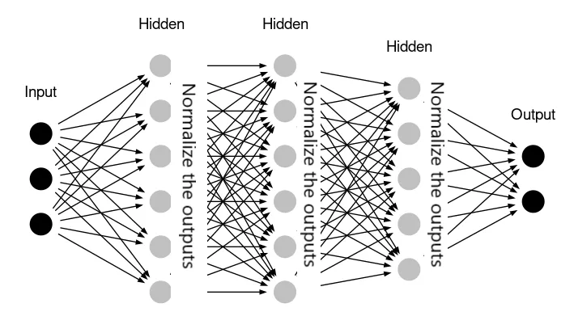
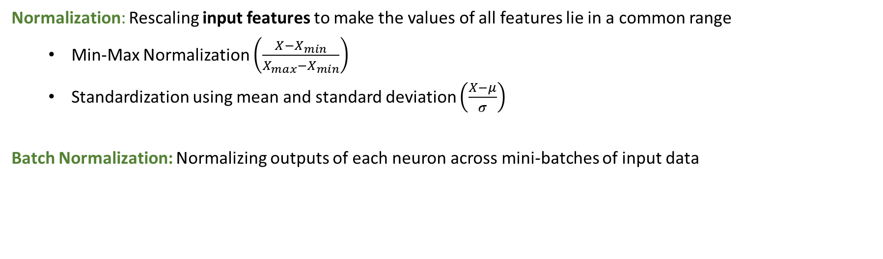
Batch Normalization
Normalization: Rescaling input features to make the values of all features lie in a common range
Min-Max Normalization $\left(\frac{X−X_{min}}{X_{max}−X_{min}}\right)$
Standardization using mean and standard deviation $\left(\frac{X−μ}{σ}\right)$
Batch Normalization: Normalizing outputs of each neuron across mini-batches of input data
Without batch normalization, output of one of the neuron can become quite large which can propagate throughout the network
Source: https://medium.com/@abheerchrome/batch-normalization-explained-1e78f7eb1e8a
Notes:
Normalization helps in training faster, prevents exploding gradients and introduces stability into the model

Slide 13
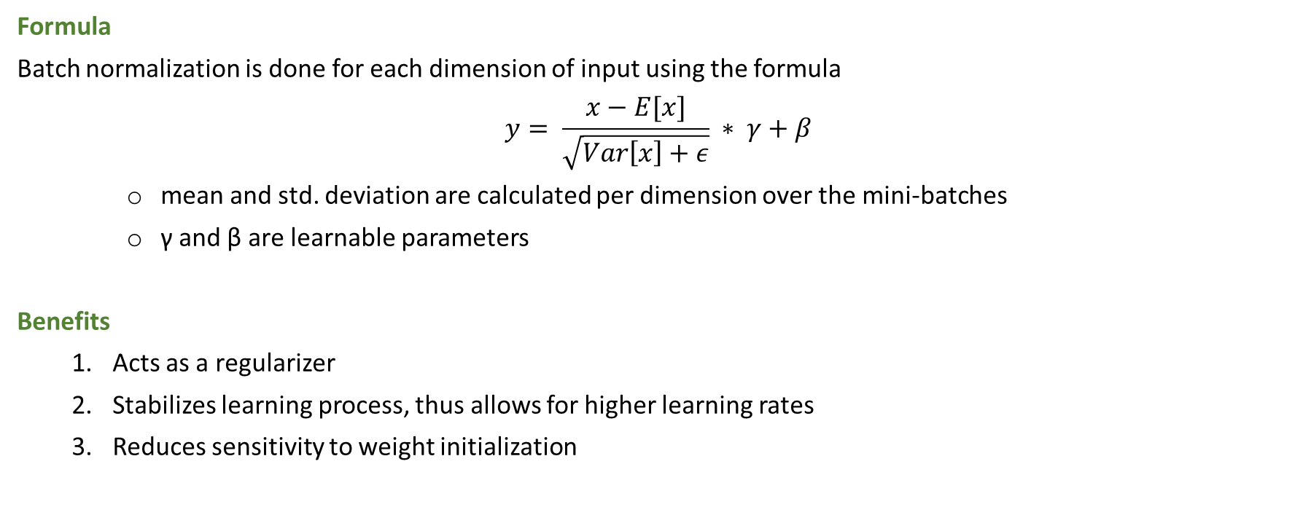
Batch Normalization
Formula
Batch normalization is done for each dimension of input using the formula
$$y= \frac{x−E[x]}{\sqrt{Var\left[x\right]+ε}} ∗ γ+β$$
mean and std. deviation are calculated per dimension over the mini-batches
γ and β are learnable parameters
Benefits
Acts as a regularizer
Stabilizes learning process, thus allows for higher learning rates
Reduces sensitivity to weight initialization
Notes:
Acts as a Regularizer: Introduces noise into the network during training, similar to the effect of dropout. The noise introduced helps prevent the model from becoming too dependent on any particular activation.
Stabilizes Learning Process: (By preventing very large output values from neurons) Allows for higher learning rates. It allows for faster convergence, thus more generalizable solutions
Weight initialization: Neural networks are highly sensitive to the initial weights. With less sensitivity to initialization, the network is less likely to get stuck in local minima that correspond to overfitting on the training data. This leads to a more robust training process.

Slide 14
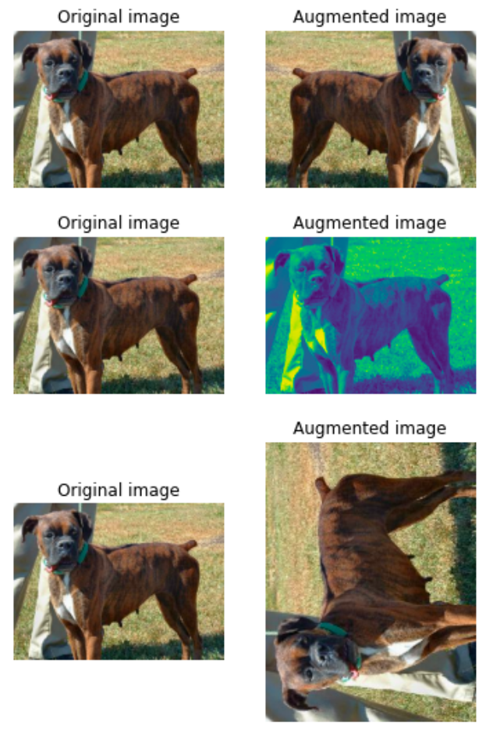
Data Augmentation
Increase the diversity of training dataset without collecting new data
by creating modified versions of existing data
Techniques for augmenting image data:
Geometric Transformations: Rotate, Zoom in or out, Flip, Crop
Color & Lighting Adjustments: Brightness, Contrast, Saturation, Hue
Noise Injection: Add random noise
Synthetic Data Generation: Using GANs (Generative Adversarial Networks)
Source: https://www.datacamp.com/tutorial/complete-guide-data-augmentation
Notes:
https://lightning.ai/docs/pytorch/2.1.0/notebooks/lightning_examples/augmentation_kornia.html

Slide 15


Data Augmentation
Techniques for augmenting audio data:
Pitch shifting
Speedup/Slowdown
Adding background noise
Techniques for augmenting textual data:
Synonyms
Translations
Adding random words for noise
Benefits
Increased Dataset Size
Improved Generalization
Understanding of Model Limitations
Notes:
By exposing the model to a variety of alterations, it learns to generalize better to new, unseen data

Slide 16
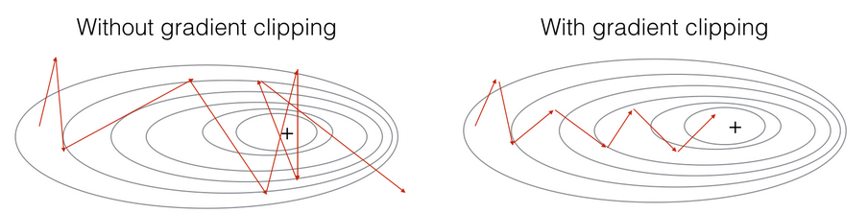
Gradient Clipping
Generally used to prevent exploding gradients
We clip the gradients to a maximum value to ensures that the gradients are scaled down to a reasonable size
Gradient clipping also acts as a form of regularization which improves the generalization of the model
Source: https://deepai.org/machine-learning-glossary-and-terms/gradient-clipping

Slide 17


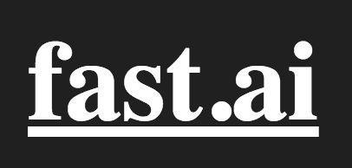

Combining all together with Lightening
High level frameworks for PyTorch for abstracting out boilerplate code

Slide 18
Finally, be carful not to underfit
Model is too simple to capture the underlying patterns in the data
Why fix underfitting?
Our effort is to train a good model with performs well on real-world data. Underfitted model doesn’t learn patterns even on training data, resulting in poor real-world performance.
Improper use of regularization techniques can results in underfitting
Fixes
Increase model complexity
Feature engineering
Fix regularization parameters
Longer training duration
Don’t underfit in an effort to mitigate overfitting

Slide 19
Techniques for further exploration
Stochastic Depth (Paper): Some layers are randomly dropped during training, but no dropping during testing
DropConnect: Generalized version of Dropout where we disable individual weights instead of neurons, so a neurons can remain partially active
AutoAugment/RandAugment (Paper): Automatically searches for the best data augmentation policies
Shake-Shake regularization (Paper): When building a deep neural network, instead of adding the outputs of each branch together, combines them in a random way during training to introduce noise
Mixout (Paper): A regularization technique similar to dropout used during transfer learning. It replaces a fraction of the model's parameters with the corresponding parameter of a pre-trained large model.
Masked Language Modeling (MLM): Used in NLP, where parts of the input are masked and the model learns to predict the masked parts

Slide 20
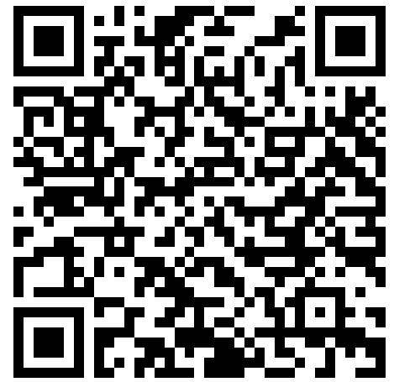
Thank you!!
Link to presentation and notebooks

